Slide 1
Aciurina

Slide 2
Ericameria

Slide 3
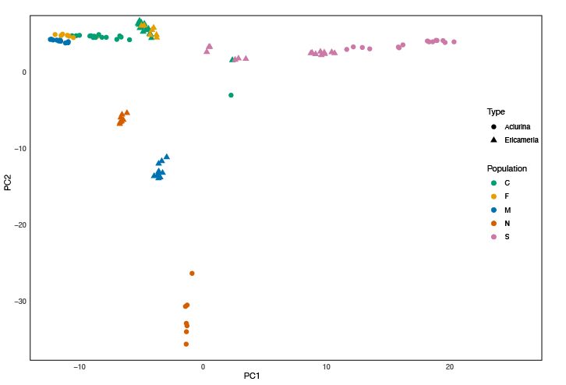

Slide 4
Aciurina

Slide 5
Ericameria

Slide 6
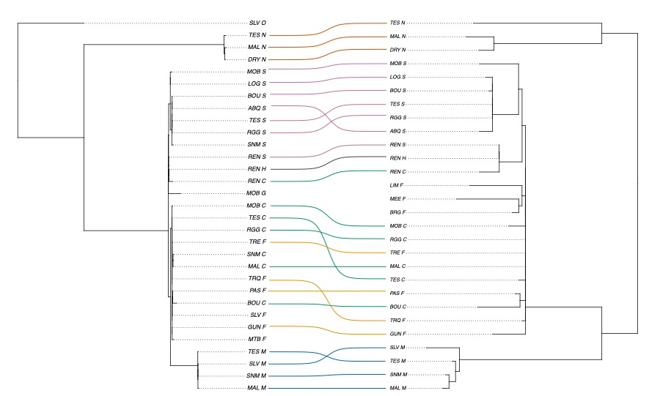
Aciurina
Ericameria

Slide 7
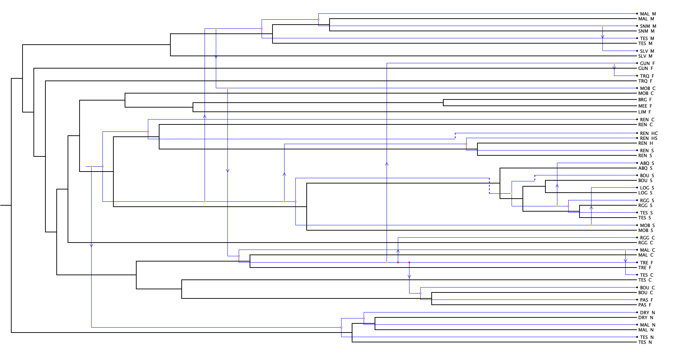
Events:
12 cospeciation
13 duplication & host switch

Slide 8
Aciurina K

Slide 9
Aciurina K

Slide 10
Aciurina K

Slide 11
Aciurina K

Slide 12
Ericameria K

Slide 13
Ericameria K

Slide 14
Ericameria K

Slide 15
Ericameria K

